Slide 1



Football IV
Produced by Dr. Mario | UNC STOR 390

Slide 2

Football Decision Making
5 Key Decisions in Football
Fourth and 4 on Opponent’s 30 Yard Line. Field Goal or Punt?
Fourth and 4 on Own 30 Yard Line. Attempt or Punt?
Gained 7 Yards on First Down From Own 30 Yard Line and Defense
Was Offsides. Accept the Penalty?
Opponent Gained 0 Yards on Run on First Down. They were
Offside. Accept the Penalty?
Optimal Run/Pass Mixture on First Down?
Decision Based on States of Football
Best Decision Maximizes the Expected Number of Points
$$Expected Points=V(Down, Yards For 1st Down, Yard Line)$$

Slide 3

Football Decision Making
Examples of Expected Points Based on States
$V\left(1,10,50\right)=1.875$
$V\left(3,3,80\right)=3.851$
$V\left(2,9,5\right)=−1.647$
Works of Konstantinos Pelechrinis
Papers on Football Strategy and

Slide 4
Football States and Values
Football States Defined by …
Yard Line
Down
Yards to Go for First Down
Score Differential
Time Left in Game
There is a Massive Amount of States
$$Number of States=99×4×30×80×60=57,024,000$$
Assumption About Yards to Go
Assumption Score Differential
Assumption About Time Remaining

Slide 5
Football States and Values
Needs Simplification
Maximize the Expected Number of Points
Assume Game is of Infinite Length
Time Remaining Becomes Irrelevant
Current Score Differential Becomes Irrelevant
Method Devalued During Ends of 2nd and 4th Quarter
New Defined States
Yard Line
Down
Yards to Go for First Down
There is a Massive Amount of States
$$Number of States=99×4×30=11,880$$

Slide 6

Football States and Values
Value of a State = Margin By Which a Team is Expected to Win
Historical Research in This Area
First Explored by Virgil Carter and Robert Machol (1971)
Modified in Hidden Game of Football (Carroll et Al., 1989)
Studied for 1st Downs by David Romer (2002) and Footballoutsiders.com
Estimated Value by Cabot, Sagarin, and Winston
Analysis Done from Different Time Periods (1969 to 2006)
Cabot, Sagarin, and Winston Used
a Video Game Pro Quarterback

Slide 7
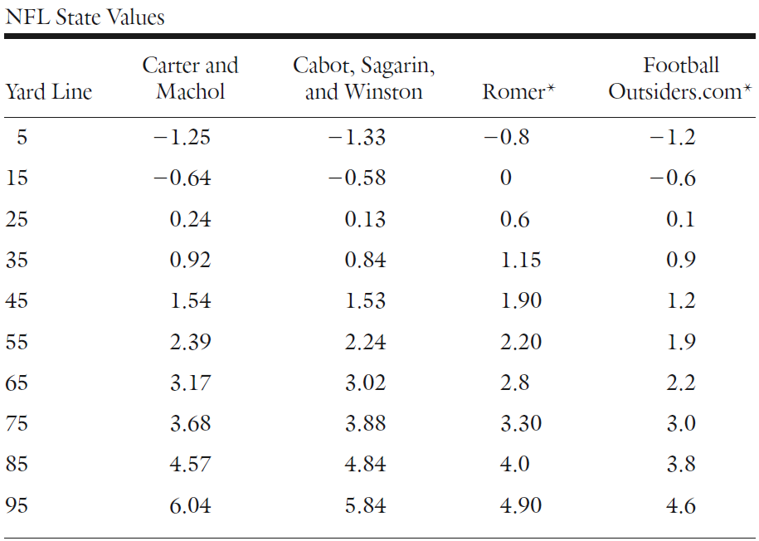
Football States and Values
Comparison of Research on State Values
Approaching Opponent’s Goal Line

Slide 8
Football States and Values
Takeaways from Analysis
Simulation in Video Game Allowed Data For Scenarios Other than 1st Down
Romer Discovered Teams Should Go on Fourth Down in Most Situations
Over NFL Season There are 40,000 Plays
This Proves That Estimated Value of States Has Considerable Error
Simplified Scenario
Football Field is 7 Yards
Need to Get 1 Yard to Get a First Down
Only Have 1 Play to Get a First Down
We Have 50% Chance of 1 Yard and 50% Chance of 0 Yards
When Scored, We Get 7 Points and Opponent Starts on 1 Yard Line
No Field Goals or Punts

Slide 9

Football States and Values
Estimating Value of Each States
There are 5 States
Expected Value of Points for Each State
Equations For Expectation (Law of conditional Expectation)
$$Expected Value at i Yard Line=V_{i}$$
$$V_{1}=0.5×V_{2}−0.5×V_{5}$$
$$V_{2}=0.5×V_{3}−0.5×V_{4}$$
$$V_{3}=0.5×V_{4}−0.5×V_{3}$$
$$V_{4}=0.5×V_{5}−0.5×V_{2}$$
$$V_{5}=0.5×(7−V_{1})−0.5×V_{1}$$
Scoring Gives the Ball to Other Team
Failing Gives the Ball to Other Team

Slide 10

Football States and Values
Estimating Value of Each States
Values Can Be Estimated Through Solving Equations
System Can Be Solved = 5 Variables and 5 Equations
Each Yard Line Increases Expectation by 3.5 Points
Is There Anything Particularly Unusual About This Methodology?
$$V_{1}=−5.25$$
$$V_{2}=−1.75$$
$$V_{3}=1.75$$
$$V_{4}=5.25$$
$$V_{5}=8.75$$

Slide 11

Football States and Values
Modification for Punts
Probability of Punting if 5, 4, 3, 2, 1 Yards Away is 0.9, 0.8, 0.2, 0.05, 0
When Punting, the Punter Kicks the Ball 1,2,3,4 Yards Away Approximately
0%, 5%, 10%, and 85% of the Time
Equations for Expectation
$$V_{1}=0.9\left[−0×V_{4}−0.05×V_{3}−0.1×V_{2}−0.85×V_{1}\right]+0.1\left[0.5×V_{2}−0.5×V_{5}\right]$$
$$V_{2}=0.8\left[−0×V_{3}−0.05×V_{2}−0.95×V_{1}\right]+0.2[0.5×V_{3}−0.5×V_{4}]$$
$$V_{3}=0.2\left[−0×V_{2}−1×V_{1}\right]+0.8[0.5×V_{4}−0.5×V_{3}]$$
$$V_{4}=0.05\left[−1×V_{1}\right]+0.95[0.5×V_{5}−0.5×V_{2}]$$
$$V_{5}=0.5×\left(7−V_{1}\right)−0.5×V_{1}$$

Slide 12

Final Inspiration
This is no democracy.
It is a dictatorship.
I am the law.
- Coach Herman Boone

